Slide 1
Simple Address Book
Case Study
Lecture 2
UML
Department of Software Engineering

Slide 2
Requirements and User Interface
Software to be designed is a program that
can be used to maintain an address book.
An address book holds a collection of
entries, each recording a person's first and
last names, address, city, state, zip, and
phone number.

Slide 3
Requirements
Features
add a new person to an address book
edit existing information about a person (except the person's name)
delete a person
Sort the entries in the address book alphabetically by last name (with ties broken by first name if necessary)
ZIP code (with ties broken by name if necessary).
print out all the entries in the address book in "mailing label" format.

Slide 4
Requirements
It must be possible to create a new address book
to open a disk file containing an existing address book
to close an address book and to save an address book to a disk file
Using standard New, Open, Close, Save and Save As ...
File menu options. The program's File menu will also have a Quit option to allow closing all open address books and terminating the program.

Slide 5
Requirements
The initial requirements call for the program to only be able to work with a single address book at a time; therefore, if the user chooses the New or Open menu option, any current address book will be closed before creating/opening a new one.
A later extension might allow for multiple address books to be open, each with its own window which can be closed separately, with closing the last open window resulting in terminating the program. In this case, New and Open will result in creating a new window, without affecting the current window.

Slide 6
Requirements
The program will keep track of whether any changes have been made to an address book since it was last saved, and will offer the user the opportunity to save changes when an address book is closed either explicitly or as a result of choosing to create/open another or to quit the program

Slide 7
Requirements
The program will keep track of the file that the current address book was read from or most recently saved to
will display the file's name as the title of the main window, and will use that file when executing the Save option.
When a New address book is initially created, its window will be titled "Untitled", and a Save operation will be converted to Save As ... - i.e. the user will be required to specify a file.

Slide 8
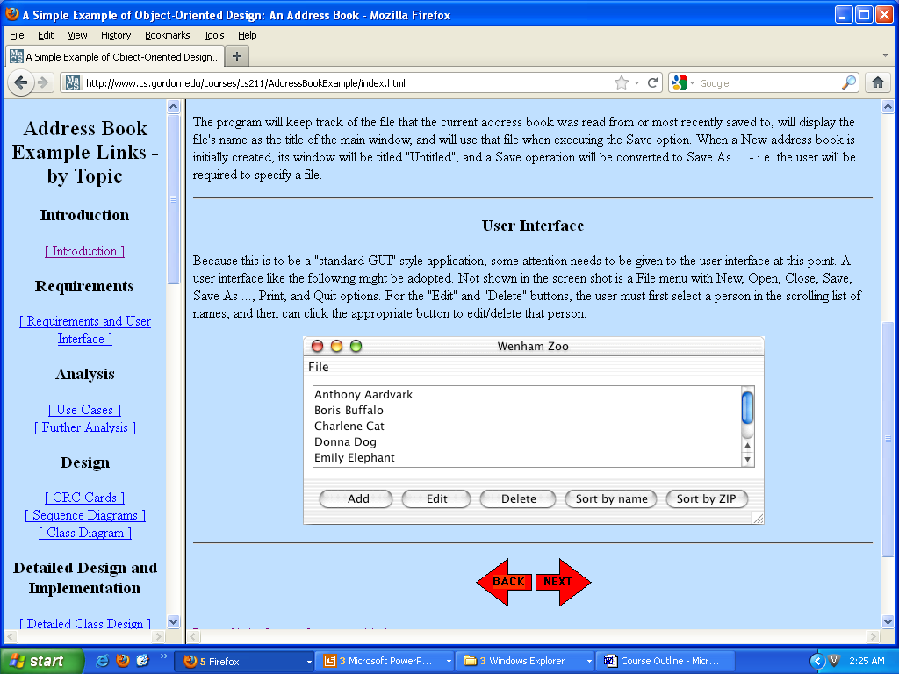
User Interface

Slide 9
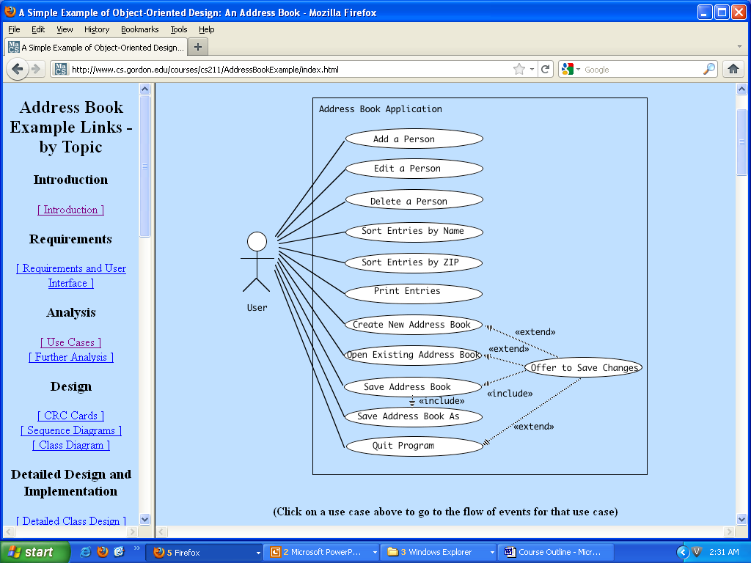
Use Cases for a Simple Address Book

Slide 10
Analysis

Slide 11
Analysis
An initial reading of the use cases suggests that the following will be part of the system.
A single entity object representing the current address book that the program is working with (AddressBook).
An arbitrary number of entity objects, each representing one of the people that is in the current address book (Person).
A boundary object representing the interface between the address book system and the human user (AddressBookGUI).
A boundary object representing the interface between the address book system and the file system on disk (FileSystem).
A controller object that carries out the use cases in response to user gestures on the GUI (AddressBookController).

Slide 12
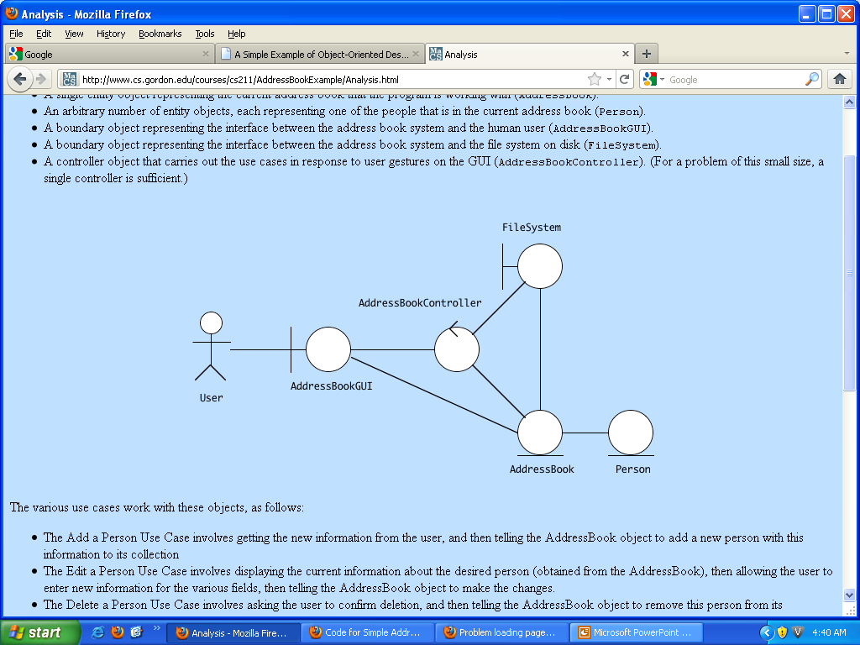

Slide 13
DESIGN (CRC Card)

Slide 14
CRC CARD
Class AddressBook
The CRC Cards for class AddressBook are left as an exercise to the student

Slide 15
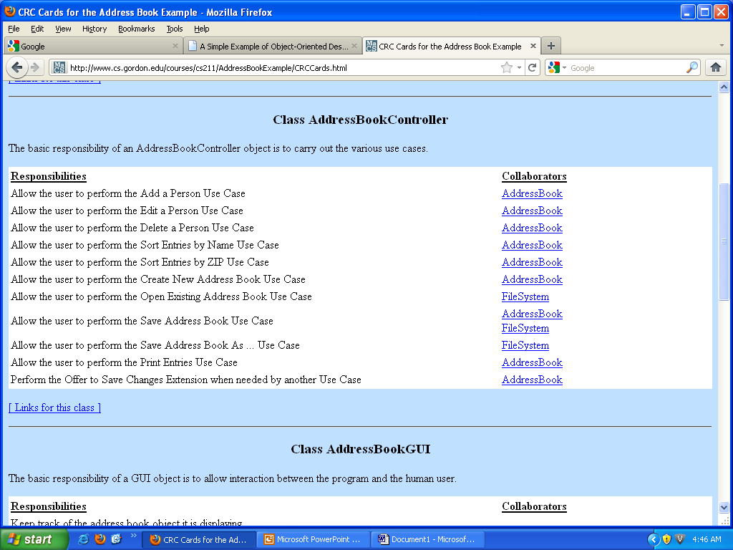

Slide 16
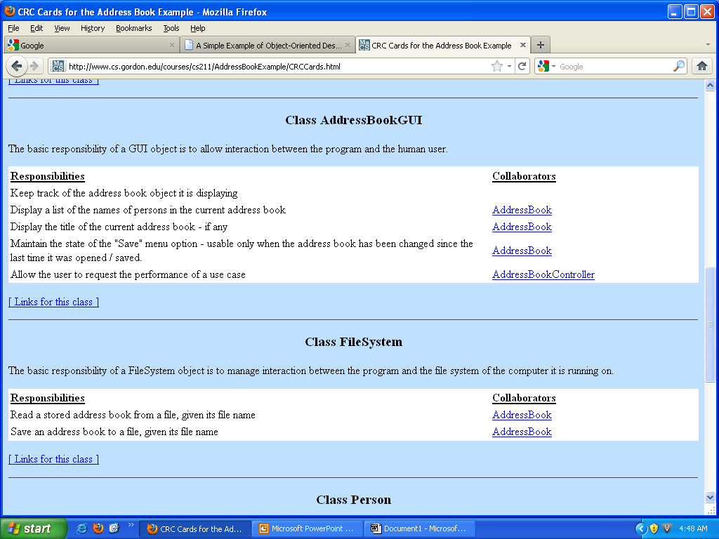

Slide 17
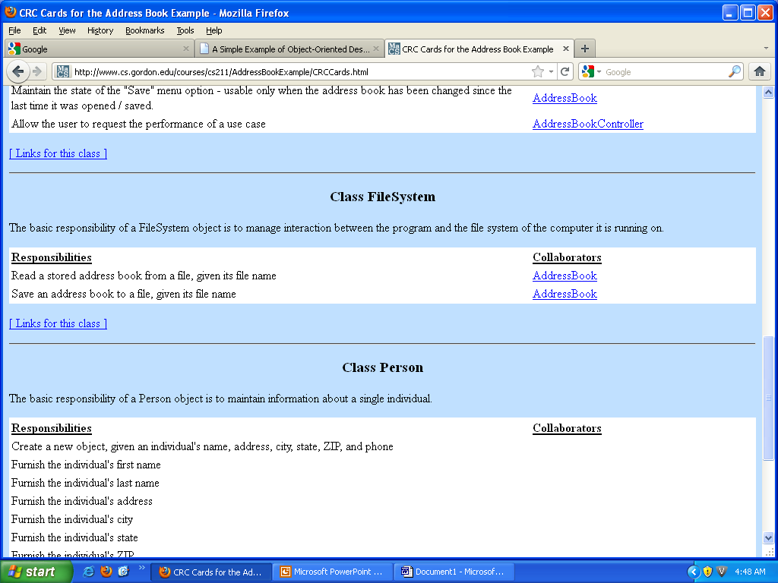

Slide 18
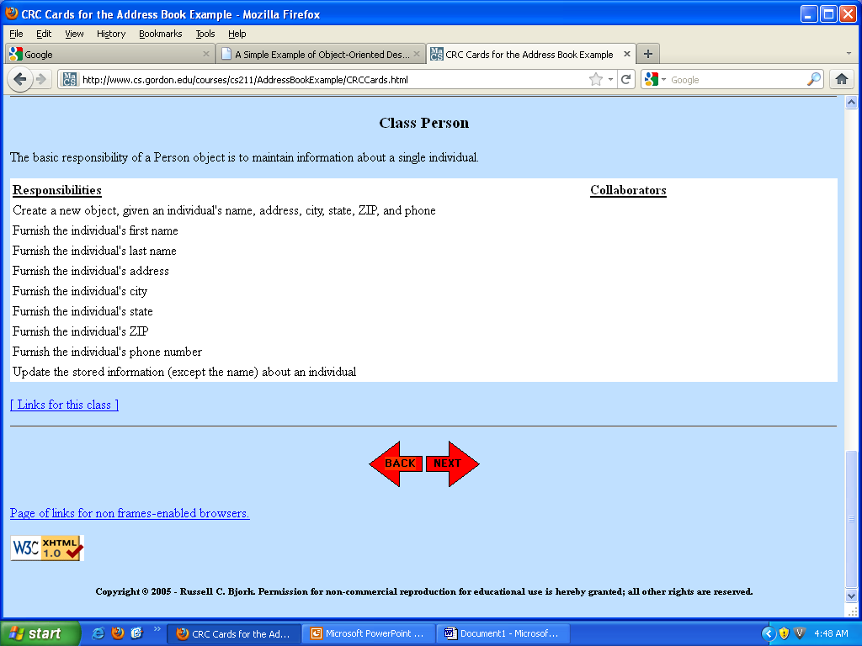

Slide 19
Design
Sequence Diagram

Slide 20
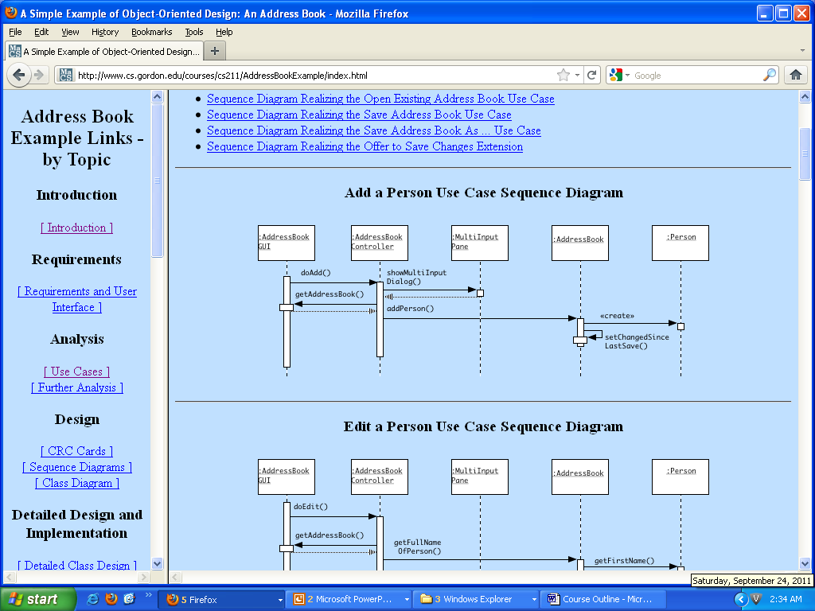
Flows of Events for Individual Use Cases

Slide 21
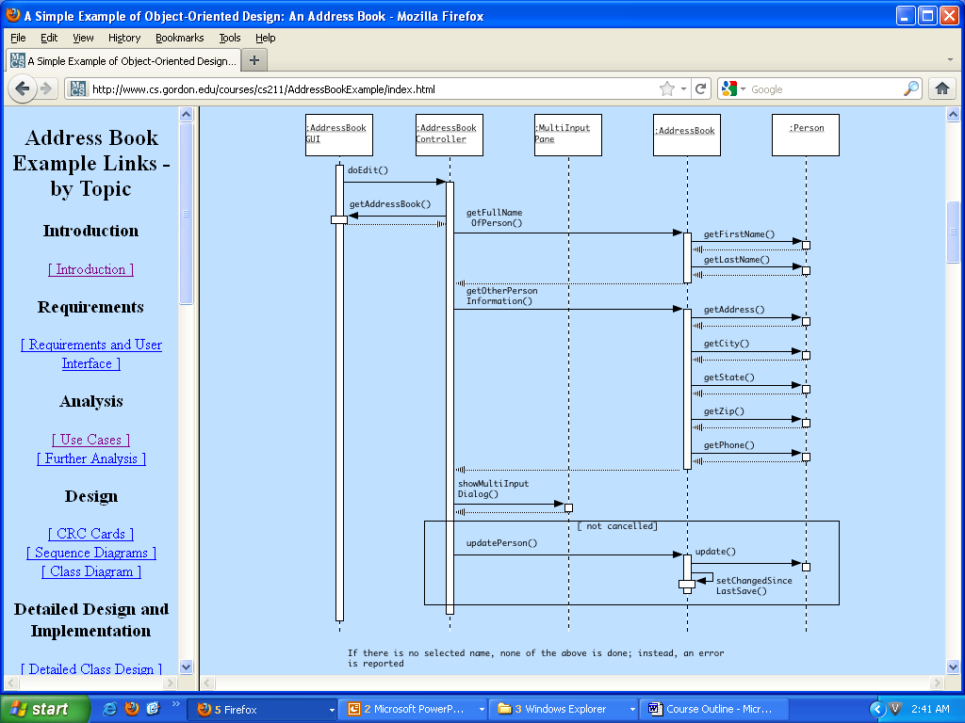
Edit a Person Use Case Sequence Diagram

Slide 22
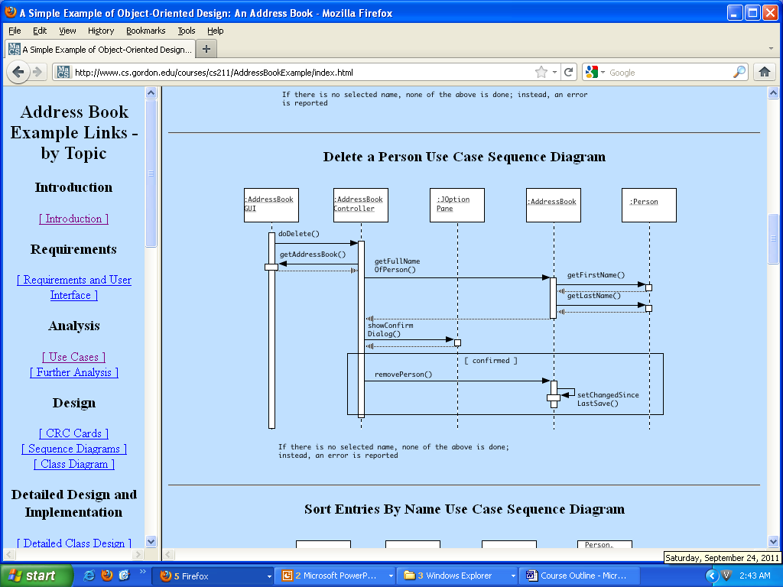
Delete a Person Use Case Sequence Diagram

Slide 23
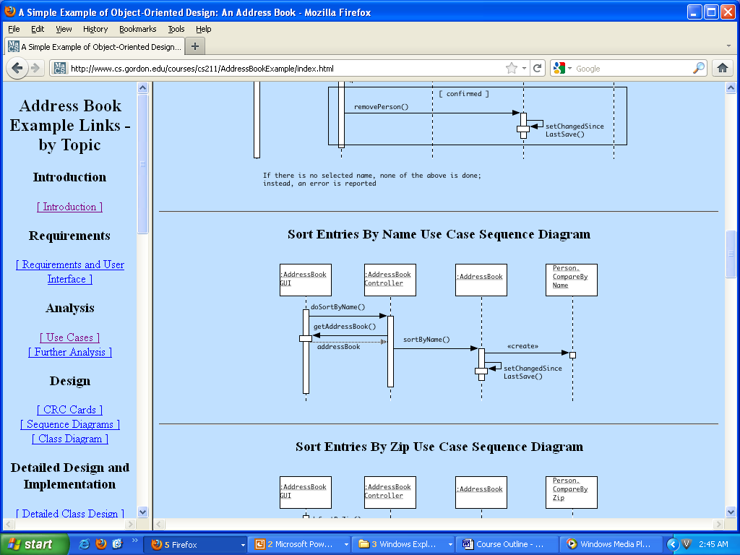
Sort Entries By Name Use Case Sequence Diagram

Slide 24
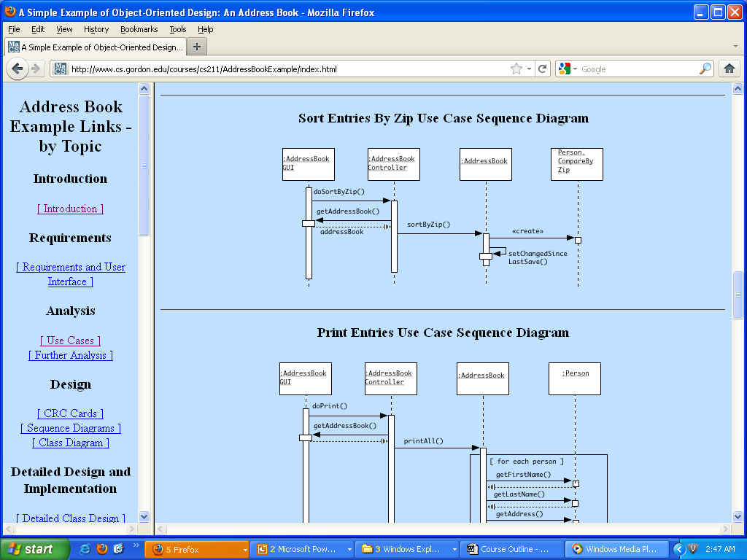
Sort Entries By Zip Use Case Sequence Diagram

Slide 25
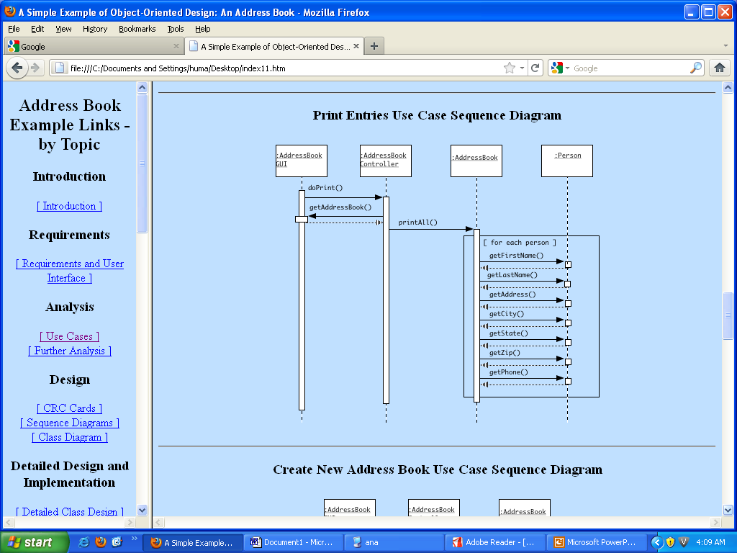

Slide 26
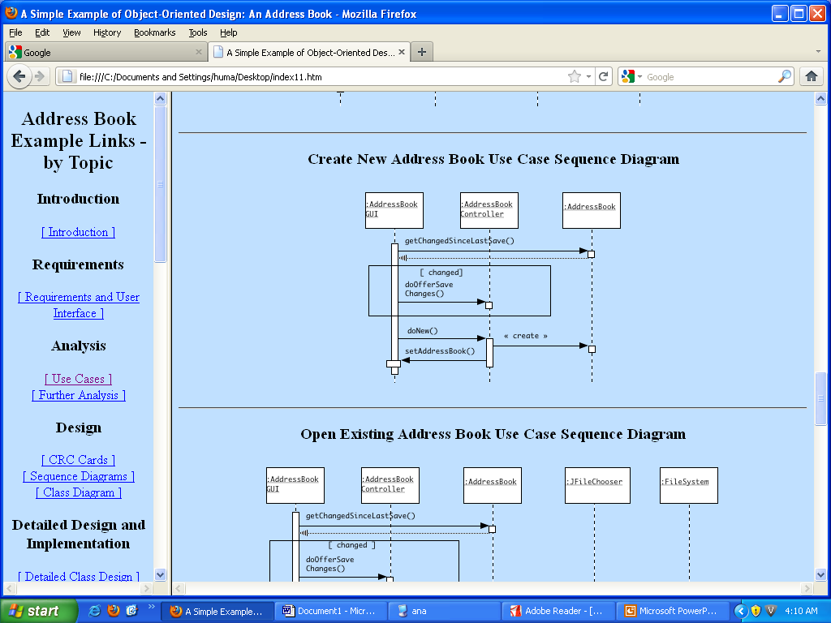

Slide 27
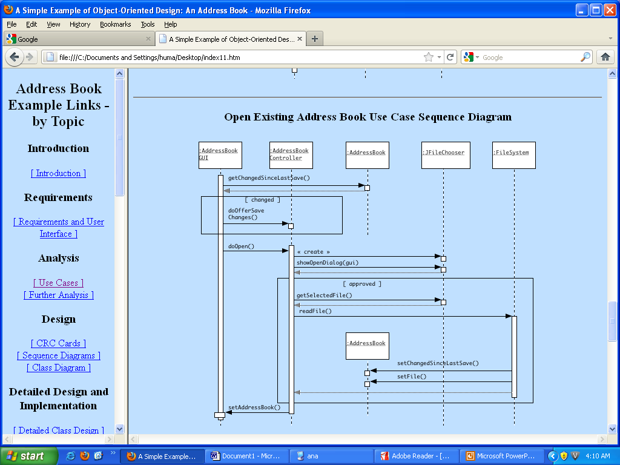
Open Existing Address Book Use Case Sequence Diagram

Slide 28
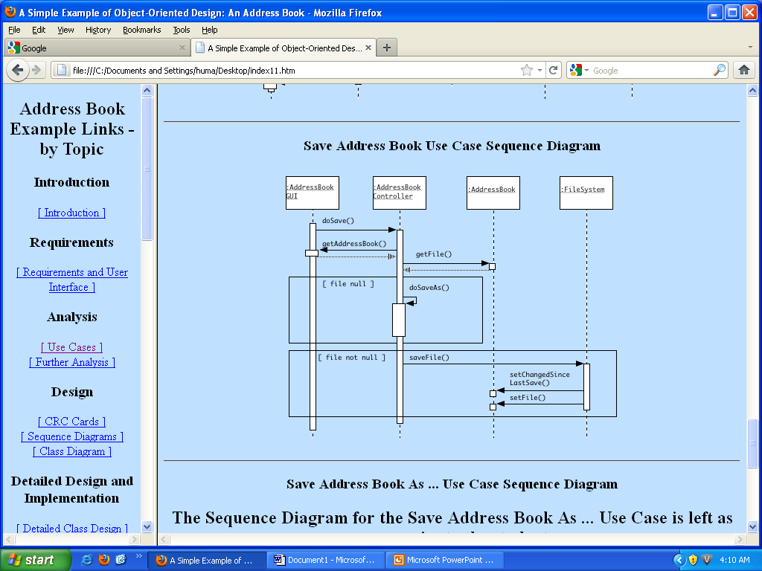

Slide 29
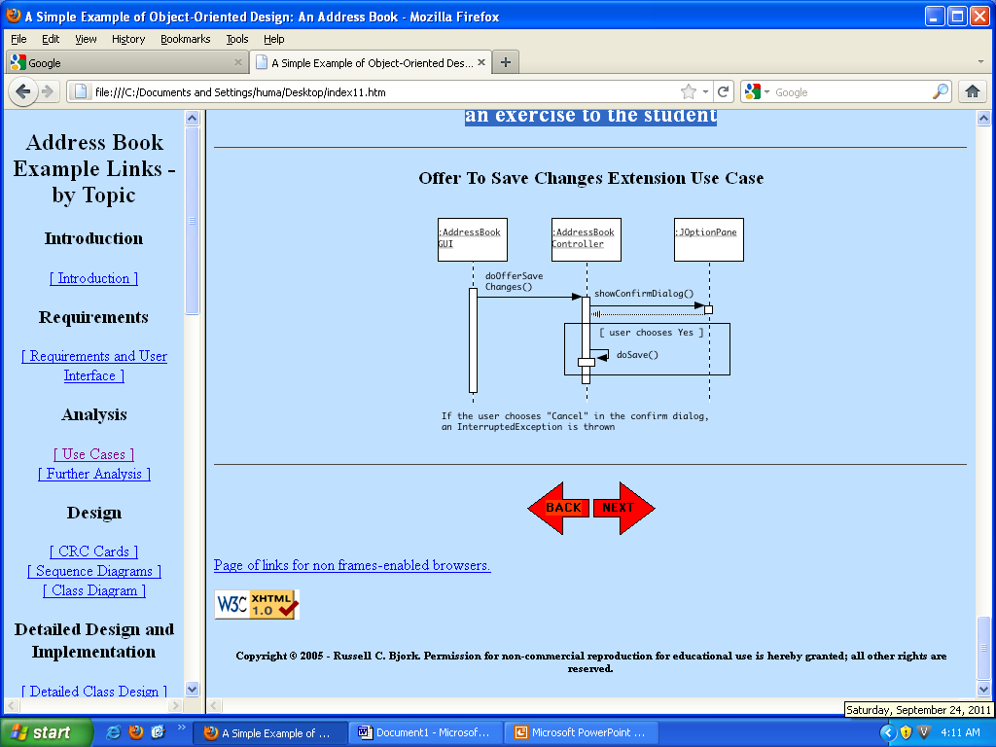

Slide 30
Assignment
Save Address Book As ... Use Case Sequence Diagram
The Sequence Diagram for the Save Address Book As ... Use Case is left as an exercise to the student

Slide 31
Design (Class Diagram)

Slide 32
Classes
AddressBookApplication - main class for the application; responsible for creating the FileSystem and GUI objects and starting up the application.
MultiInputPane - a utility class for reading multiple values at a single time.
Person.CompareByName - Comparator for comparing two Person objects by name (used for sorting by name).
Person.CompareByZip - Comparator for comparing two Person objects by zip (used for sorting by name).

Slide 33
Relationship
The following relationships hold between the objects:
The main application object is responsible for creating a single file system object and a single controller object.
The file system object is responsible for saving and re-loading address books
The controller object is responsible for creating a single GUI object.
The controller object is responsible for initially creating an address book object, but the GUI is henceforth responsible for keeping track of its current address book - of which it only has one at any time.
The GUI object and the address object are related by an observer-observable relationship, so that changes to the address book content lead to corresponding changes in the display
The address book object is responsible for creating and keeping track of person objects, of which there can be many in any given address book.
A MultiInputPane object is used by the controller to allow the user to enter multiple items of data about a person.
A comparator object of the appropriate kind is used by the address book object when sorting itself.

Slide 34
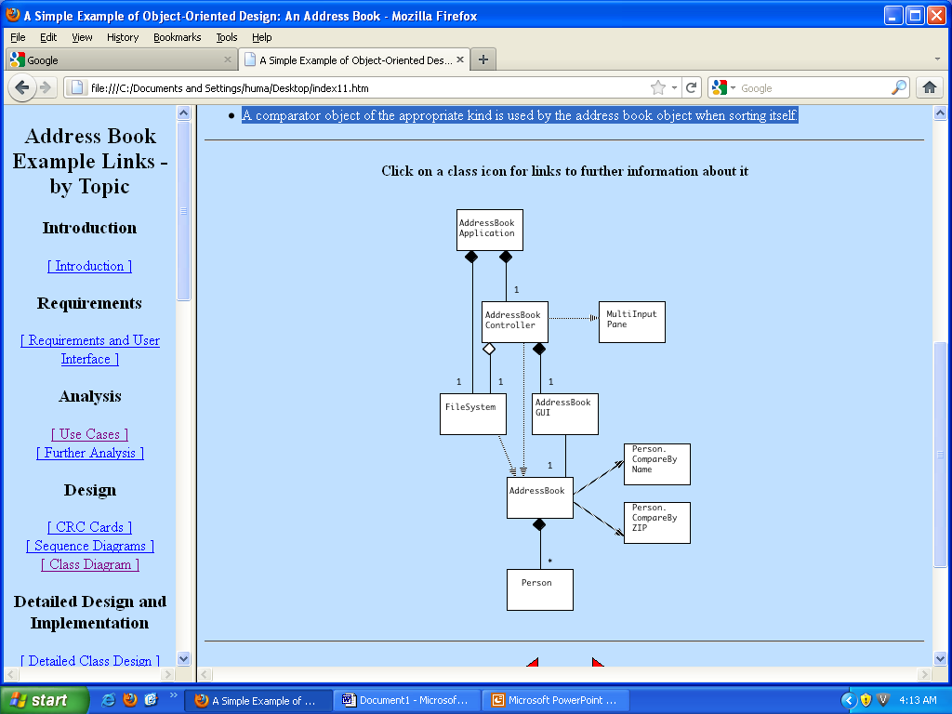
CLASS Diagram

Slide 35
Detailed Design and Implementation
Detailed Class Design

Slide 36
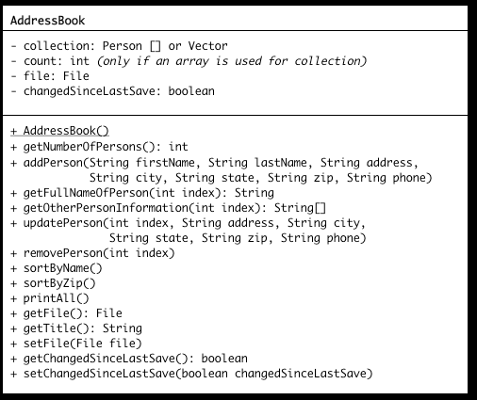
Class AddressBook

Slide 37
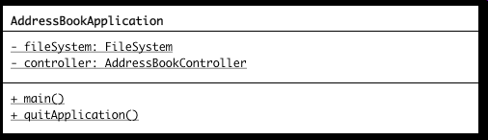
Class AddressBookApplication

Slide 38
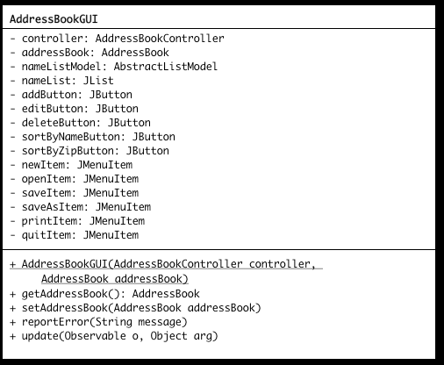
AddressBookGUI

Slide 39
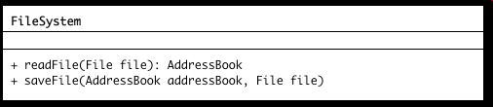
Class FileSystem

Slide 40
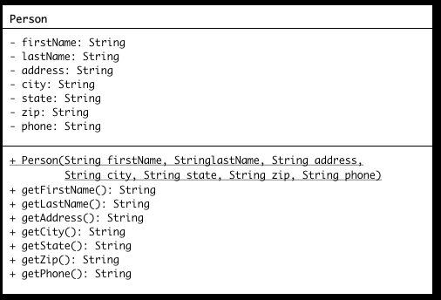
Person

Slide 41
Assignment
The detailed design of class AddressBookController is left as an exercise to the student

Slide 42
Code for Simple Address Book Example
/*
* AddressBookApplication.java
*
* Main program for address book application
*
* Copyright (c) 2001, 2003, 2005 - Russell C. Bjork
*
*/
import java.awt.Frame;
import java.awt.event.WindowEvent;
// The next line is only needed on the Mac platform - comment out
// if compiling on some other platform (but comment back in and recompile
// before moving final version to server)
import com.apple.eawt.*;
/** Main class for the Address Book example
*/
}

Slide 43
Code for Simple Address Book Example
public class AddressBookApplication
{
/** Main method for program
*/
public static void main(String [] args)
{
FileSystem fileSystem = new FileSystem();
AddressBookController controller = new AddressBookController(fileSystem);
AddressBookGUI gui = new AddressBookGUI(controller, new AddressBook());
gui.show();
// Register a Mac quit handler - comment out if compiling on some
// other platform (but comment back in and recompile
// before moving final version to server)
com.apple.eawt.Application application =
com.apple.eawt.Application.getApplication();
application.addApplicationListener(new ApplicationAdapter() {
public void handleQuit(ApplicationEvent e)
{
e.setHandled(false);
quitApplication();
}
});

Slide 44
Code for Simple Address Book Example
/** Terminate the application (unless cancelled by the user)
*/
public static void quitApplication()
{
// When the user requests to quit the application, any open
// windows must be closed
Frame [] openWindows = Frame.getFrames();
for (int i = 0; i < openWindows.length; i ++)
{
// Attempt to close any window that belongs to this program
if (openWindows[i] instanceof AddressBookGUI)
{
openWindows[i].dispatchEvent(new WindowEvent(
openWindows[i],

Slide 45
Code for Simple Address Book Example
WindowEvent.WINDOW_CLOSING));
// If the window is still showing, this means that this attempt
// to close the window was cancelled by the user - so abort the
// quit operation
if (openWindows[i].isShowing())
return;
}
}
// If we get here, all open windows have been successfully closed
// (i.e. the user has not cancelled an offer to save any of them).
// Thus, the application can terminate.
System.exit(0);
}
}

Slide 46
Testing

Slide 47
Maintenance

Slide 48
Maintenance
The Print Entries Use Case currently sends printed output to System.out. Alternately, it could send its output to a file, chosen by the user in response to a file dialog.
It was noted in the orginal requirements that the program might be modified to allow multiple address books to be open at the same time - each in its own window. This might entail the following changes:

Slide 49
Maintenance
The Create New Address Book and Open Existing Address Book Use Cases would no longer close the current address book. Instead, they would create a new copy of the GUI, with its own address book (either a newly created, empty one, or one read from a file specified by the user.) There would thus be two (or more) windows visible on the screen.
A new Close Address Book Use Case would be added to allow the user to close a single window (and its associated address book). This could be initiated by a new Close option in the File menu, or by clicking the close box for the window. It would offer to save changes, if necessary, and then close the window. If the window that is closed is the last open window in the program, then the program should be terminated as well; otherwise, the program would continue running with the remaining window(s) visible.

Slide 50
Maintenance
The code that is activated when the close box for the window is clicked would be the Close Address Book Use Case described above, instead of the Quit Program Use Case.
The Quit Program Use Case (activated from the Quit item in the File menu) would need to cause all open windows to be closed, with appropriate offers to save changes, unless the user cancels the operation for any window. If the user cancels the save for any window, the entire use case would terminate at once, without attempting to close additional windows.

Slide 51
Maintenance
A facility might be created that would allow the user to search for the occurrence of some character string anywhere in the information about a person. For example, searching for the string "Buffalo" might find Boris Buffalo or a person living in Buffalo, NY; searching for the string "0191" might find a person living in ZIP code 01915 or a person whose phone number is 555-0191, etc. This might entail adding two new use cases: Find and Find Again.

Slide 52
Development Approaches
How implementation is organized
Top-Down Development
Bottom-Up Development

Slide 53
Top-Down Development
Start from system-level modules
Gradually decompose into submodules
Uses stubs initially

Slide 54
Bottom-Up Development
Start from low-level utilities
Build system by integration
Encourages reuse

Slide 55
Top-Down vs Bottom-Up
Top-Down: System first, late testing
Bottom-Up: Components first, early testing

Slide 56
Industry Practice
Hybrid approach is common
Architecture top-down
Components bottom-up

